Slide 1
Parameter shift in neural net
3/7/2021

Slide 2

1. Intro
Assume: $f\left(x\right)=x^{2}+cos⁡(x+2)$
We can calculate $f^{′}\left(x\right)=r(f\left(x+ε\right)−f\left(x−ε\right))$ $(1)$ directly.
But what values of $r$ and $ε$? Is it exist?

Slide 3

2. Experiments
Assume $r∈\left(−10,10\right),ε∈(−5,5)$, substitute $r_{i},ε_{i}$ into the equation (1) and calculate loss $|f^{′}\left(x\right)−\hat{f′(x)}|$

Slide 4
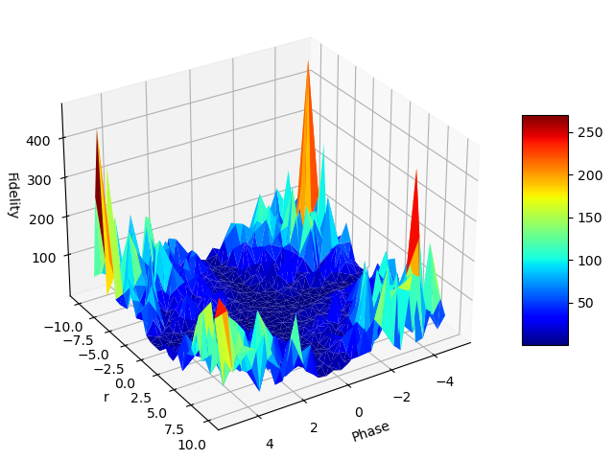

2. Experiments
With the smallest share $Δr≈0.5, Δ≈0.3$.
$$loss_{min}=0.00x$$

Slide 5
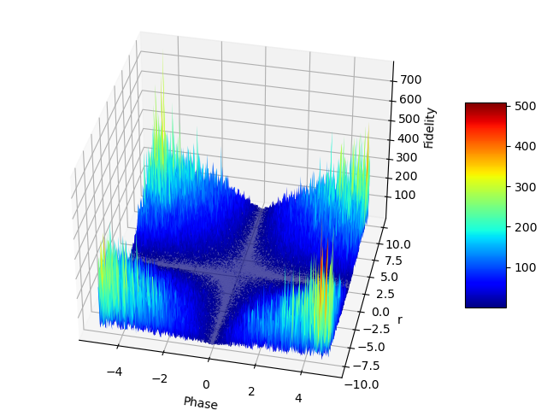

2. Experiments
With the smallest share $Δr≈0.05, Δ≈0.03$.
$$loss_{min}=0.000x$$

Slide 6

2. Experiments
With the smallest share $Δr≈0.005, Δ≈0.003$.
$$loss_{min}≈10e^{−7}$$

Slide 7
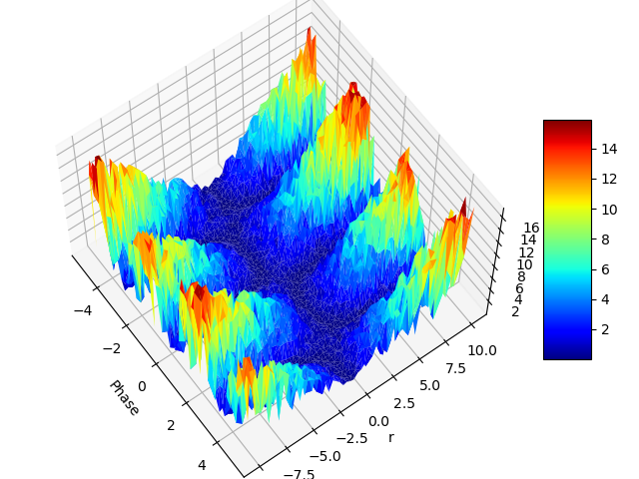

3. Guess
For any differentiable function $f$, exist some $r$ and $ε$ satisfy (1).
- Cyclicity: high oppoturnity to find $r, ε$

Slide 8
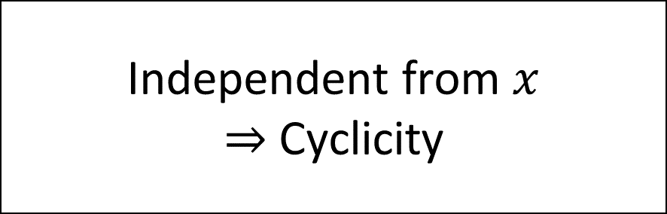
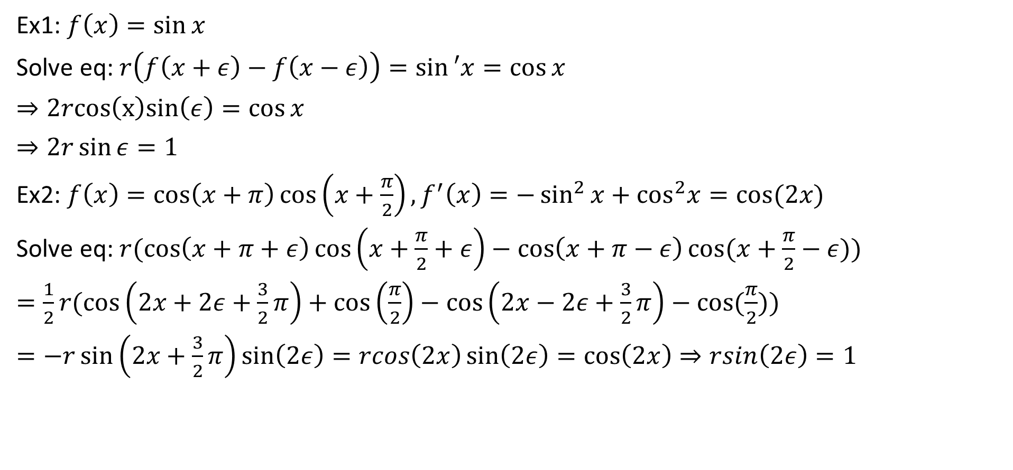

3. Guess
Independent from $x$
$⇒$ Cyclicity
Ex1: $f\left(x\right)=sin⁡x$
Solve eq: $r\left(f\left(x+ε\right)−f\left(x−ε\right)\right)=\sin{′x}=cos⁡x$
$⇒2rcos\left(x\right)sin\left(ε\right)=\cos{x}$
$⇒2r\sin{ε}=1$
Ex2: $f\left(x\right)=\cos\left(x+π\right)\cos\left(x+\frac{π}{2}\right),f^{′}\left(x\right)=−\sin^{2}{x}+\cos^{2}x=cos(2x)$
Solve eq: $r(\cos\left(x+π+ε\right)\cos\left(x+\frac{π}{2}+ε\right)−\cos\left(x+π−ε\right)\cos{(x+\frac{π}{2}−ε)})$
$=\frac{1}{2}r(\cos\left(2x+2ε+\frac{3}{2}π\right)+\cos\left(\frac{π}{2}\right)−\cos\left(2x−2ε+\frac{3}{2}π\right)−cos⁡(\frac{π}{2}))$
$=−r\sin\left(2x+\frac{3}{2}π\right)\sin\left(2ε\right)=rcos\left(2x\right)\sin\left(2ε\right)=\cos\left(2x\right)⇒rsin\left(2ε\right)=1$

Slide 9
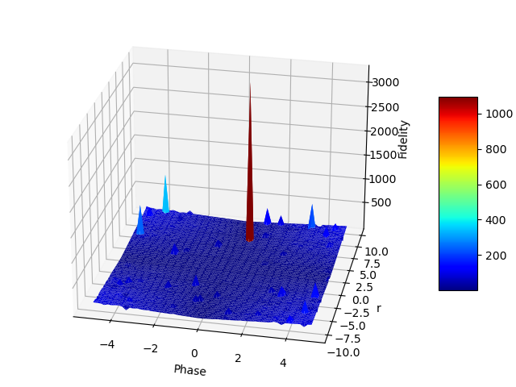
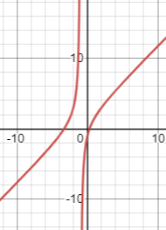

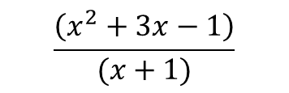
3. Guess
Non cyclicity: if $f$ is not differentiable at some points
$$\frac{\left(x^{2}+3x−1\right)}{(x+1)}$$

Slide 10
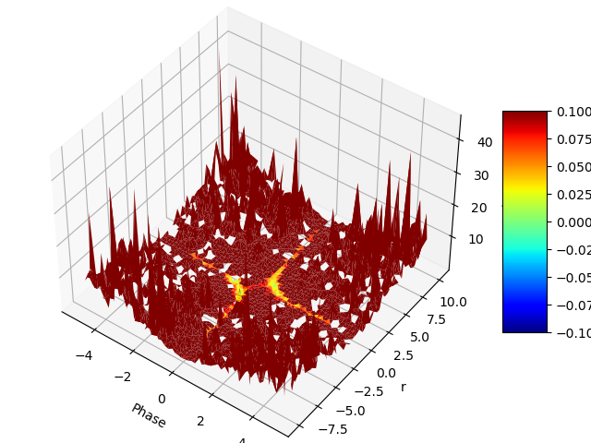



3. Guess
Singularity: if $f$ is not differentiable at some points
$$ln⁡(x)$$

Slide 11


3. Guess
Dependent on $x$
$⇒$ Non cyclicity
Ex3: $f\left(x\right)=x^{2}+cos⁡(x+2)$, $f^{′}\left(x\right)=2x−sin⁡(x+2)$
Solve eq: $r\left({\left(x+ε\right)}^{2}+\cos\left(x+2+ε\right)−{\left(x−ε\right)}^{2}−\cos\left(x+2−ε\right)\right)=2x−sin⁡(x+2)$
$⇒r(4xε−2\sin\left(x+2\right)\sin\left(ε\right)=2x−sin⁡(x+2)$
$⇒4xrε−2x=sin⁡(x+2)(2\sin{ε}−1)$
$⇒\frac{2rε−1}{2\sin{ε}−1}=\frac{\sin\left(x+2\right)}{2x}$

Slide 12

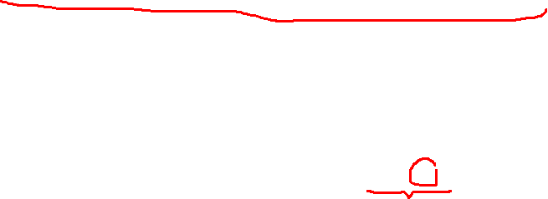
3. Guess
Dependent on $x$
$⇒$ Non cyclicity
Ex4: $f\left(x\right)=\ln\left(x\right),f^{′}\left(x\right)=\frac{1}{x}$
Solve eq: $r\left(\ln\left(x+ε\right)−\ln\left(x−ε\right)\right)=\frac{1}{x}$
Taylor series:
$$\ln\left(x+ε\right)=\ln\left(x\right)+\frac{1}{x}ε−\frac{1}{2!\left(x^{2}\right)}ε^{2}+…+O(ε^{2})$$
$$\ln\left(x−ε\right)=\ln\left(x\right)+\frac{1}{x}(−ε)−\frac{1}{2!\left(x^{2}\right)}ε^{2}+…+O(ε^{2})$$
$$⇒r\left(\frac{2ε}{x}\right)+O\left(ε^{2}\right)=\frac{1}{x}⇒2rε≈1$$

Slide 13

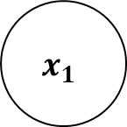

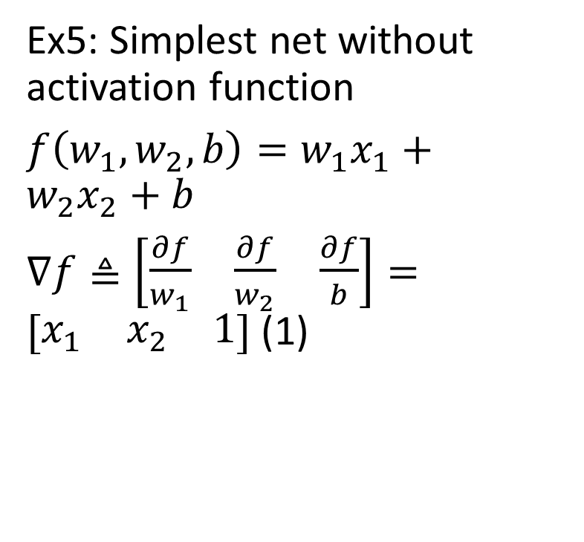


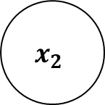
4. In neural net
1
Ex5: Simplest net without activation function
$f\left(w_{1},w_{2},b\right)=w_{1}x_{1}+w_{2}x_{2}+b$
$∇f≜\left[\begin{matrix}\frac{∂f}{w_{1}} & \frac{∂f}{w_{2}} & \frac{∂f}{b}\end{matrix}\right]=[\begin{matrix}x_{1} & x_{2} & 1\end{matrix}]$ (1)
$$b$$
$$x_{1}$$
$$w_{1}$$
+,*
$$f$$
$$x_{2}$$
$$w_{2}$$

Slide 14
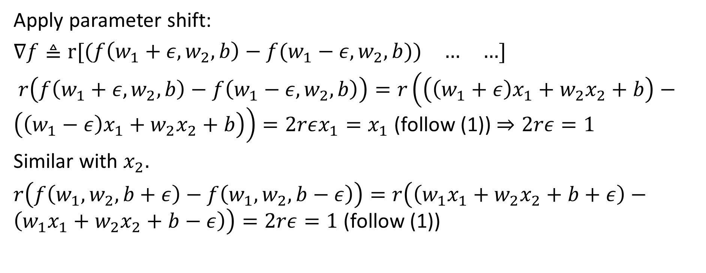
4. In neural net
Apply parameter shift:
$∇f≜r[\begin{matrix}(f\left(w_{1}+ε,w_{2},b\right)−f(w_{1}−ε,w_{2},b)) & … & …\end{matrix}]$
$r\left(f\left(w_{1}+ε,w_{2},b\right)−f\left(w_{1}−ε,w_{2},b\right)\right)=r\left(\left(\left(w_{1}+ε\right)x_{1}+w_{2}x_{2}+b\right)−\left(\left(w_{1}−ε\right)x_{1}+w_{2}x_{2}+b\right)\right)=2rεx_{1}=x_{1}$ (follow (1)) $⇒2rε=1$
Similar with $x_{2}.$
$r\left(f\left(w_{1},w_{2},b+ε\right)−f\left(w_{1},w_{2},b−ε\right)\right)=r\left(\left(w_{1}x_{1}+w_{2}x_{2}+b+ε\right)−\left(w_{1}x_{1}+w_{2}x_{2}+b−ε\right)\right)=2rε=1$ (follow (1))

Slide 15
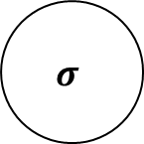
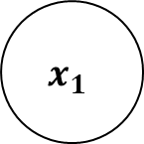

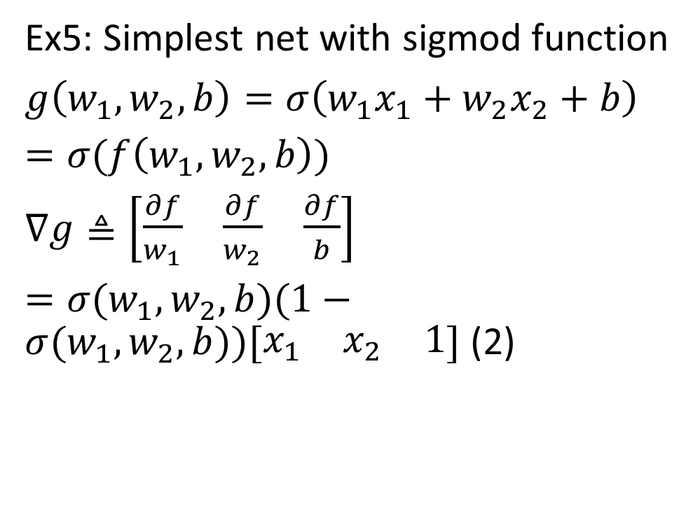




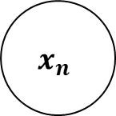

4. In neural net
1
Ex5: Simplest net with sigmod function
$g\left(w_{1},w_{2},b\right)=σ\left(w_{1}x_{1}+w_{2}x_{2}+b\right)$
$=σ(f\left(w_{1},w_{2},b\right))$
$∇g≜\left[\begin{matrix}\frac{∂f}{w_{1}} & \frac{∂f}{w_{2}} & \frac{∂f}{b}\end{matrix}\right]$
$=σ(w_{1},w_{2},b)(1−σ(w_{1},w_{2},b))[\begin{matrix}x_{1} & x_{2} & 1\end{matrix}]$ (2)
$$b$$
$$x_{1}$$
$$w_{1}$$
+,*
$$σ$$
$$…$$
$$x_{n}$$
$$w_{n}$$
$$f(w,b)$$
$$g(w,b)$$

Slide 16
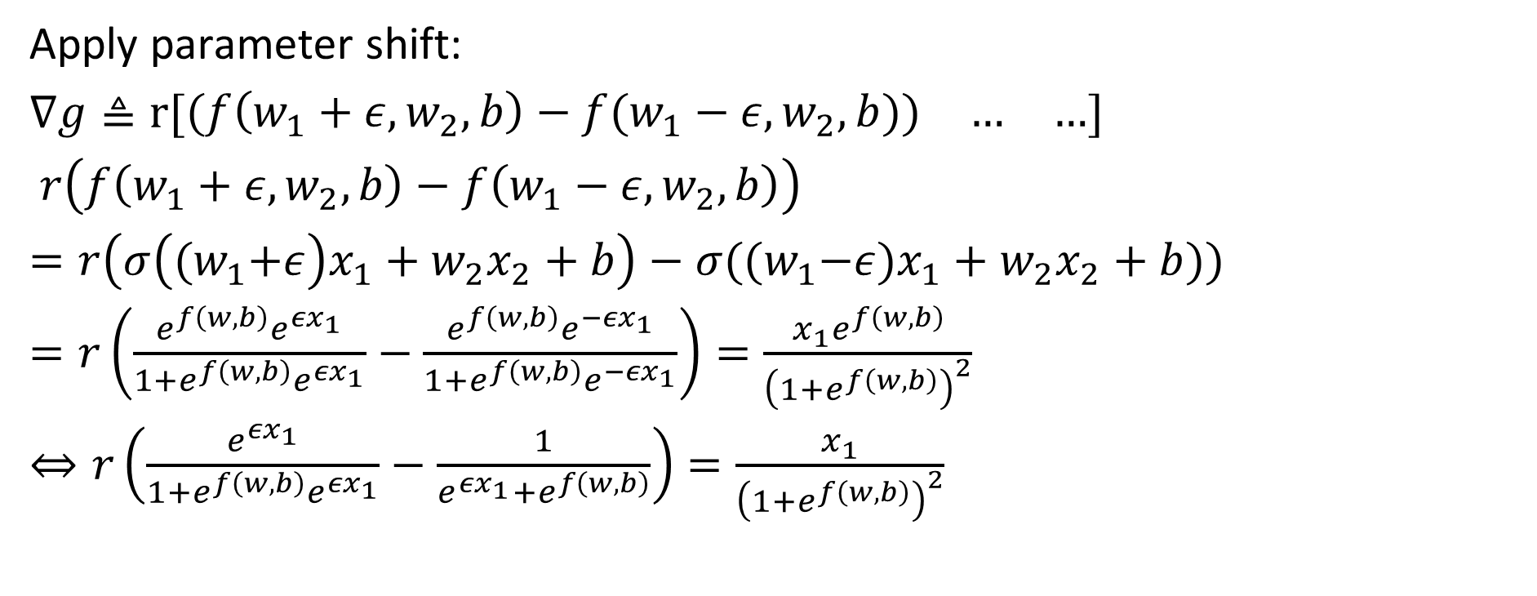

4. In neural net
Apply parameter shift:
$∇g≜r[\begin{matrix}(f\left(w_{1}+ε,w_{2},b\right)−f(w_{1}−ε,w_{2},b)) & … & …\end{matrix}]$
$r\left(f\left(w_{1}+ε,w_{2},b\right)−f\left(w_{1}−ε,w_{2},b\right)\right)$
$=r\left(σ\left({(w}_{1}+ε\right)x_{1}+w_{2}x_{2}+b\right)−σ({(w}_{1}−ε)x_{1}+w_{2}x_{2}+b))$
$=r\left(\frac{e^{f\left(w,b\right)}e^{{εx}_{1}}}{1+e^{f\left(w,b\right)}e^{{εx}_{1}}}−\frac{e^{f\left(w,b\right)}e^{−{εx}_{1}}}{1+e^{f\left(w,b\right)}e^{{−εx}_{1}}}\right)=\frac{x_{1}e^{f\left(w,b\right)}}{{\left(1+e^{f\left(w,b\right)}\right)}^{2}}$
$⇔r\left(\frac{e^{{εx}_{1}}}{1+e^{f\left(w,b\right)}e^{{εx}_{1}}}−\frac{1}{e^{{εx}_{1}}+e^{f\left(w,b\right)}}\right)=\frac{x_{1}}{{\left(1+e^{f\left(w,b\right)}\right)}^{2}}$

Slide 17
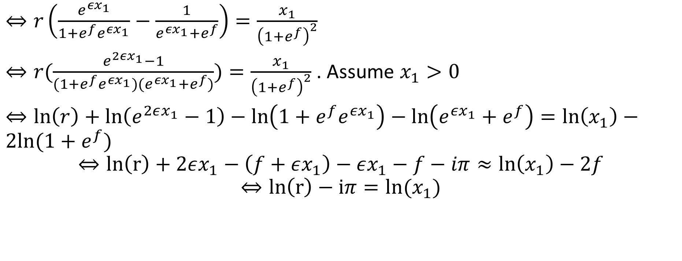
4. In neural net
$⇔r\left(\frac{e^{{εx}_{1}}}{1+e^{f}e^{{εx}_{1}}}−\frac{1}{e^{{εx}_{1}}+e^{f}}\right)=\frac{x_{1}}{{\left(1+e^{f}\right)}^{2}}$
$⇔r(\frac{e^{2εx_{1}}−1}{(1+e^{f}e^{{εx}_{1}})(e^{{εx}_{1}}+e^{f})})=\frac{x_{1}}{{\left(1+e^{f}\right)}^{2}}$ . Assume $x_{1}>0$
$⇔\ln\left(r\right)+\ln\left(e^{2εx_{1}}−1\right)−\ln\left(1+e^{f}e^{{εx}_{1}}\right)−\ln\left(e^{{εx}_{1}}+e^{f}\right)=\ln\left(x_{1}\right)−2ln⁡(1+e^{f})$
$$⇔ln\left(r\right)+2εx_{1}−\left(f+εx_{1}\right)−εx_{1}−f−iπ≈\ln\left(x_{1}\right)−2f$$
$$⇔ln\left(r\right)−iπ=ln⁡(x_{1})$$

